Slide 1



Introducing Sass
CSS Preprocessor
Balaji B
Assoc Software developer - IQVIA

Slide 2

Cautions
⚠️
If anyone already familiar with this topic.
Please help me in personal chat if I’m wrong during the presentation.
My second screen open to you.

Slide 3

What is Sass?
1
Definition
Sass is a CSS preprocessor scripting language that is interpreted or compiled into cascading style sheet.
Sass stands for “Syntactically Awesome style sheets”
Sass is the most mature, stable and powerful professional grade CSS extension language in the world.
May this boring word confuse you.
Don’t worry, Next slide have the perfect definition.

Slide 4


A meme is better than a thousand words ✅
*SASS
*CSS
*SASS
*CSS
This is actually CSS, with some super powers.

Slide 5
Key Features of Sass
1
Variables
2
Nesting
3
Partials
4
Interpolations
5
Inheritance
6
Mixins
7
Functions
8
Flow controls

Slide 6
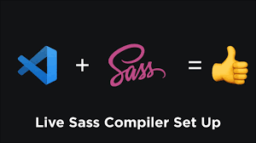
Installation

Slide 7
Sass Syntax
Explanation
Sass syntax can be written in two formats:
SCSS - We are going to work.
SASS - The indented syntax > Complex for developer so most will follow the scss.

Slide 8
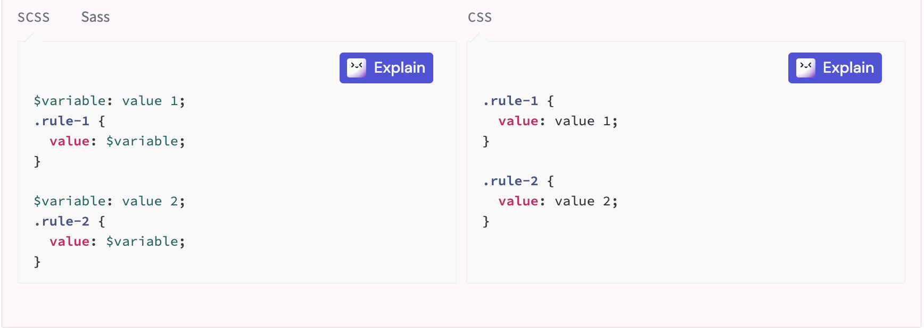
Variables
CSS variables vs Sass variables
Global vs local scoped variables
Advanced Variables with “map get” build in function
!default values to variables

Slide 9
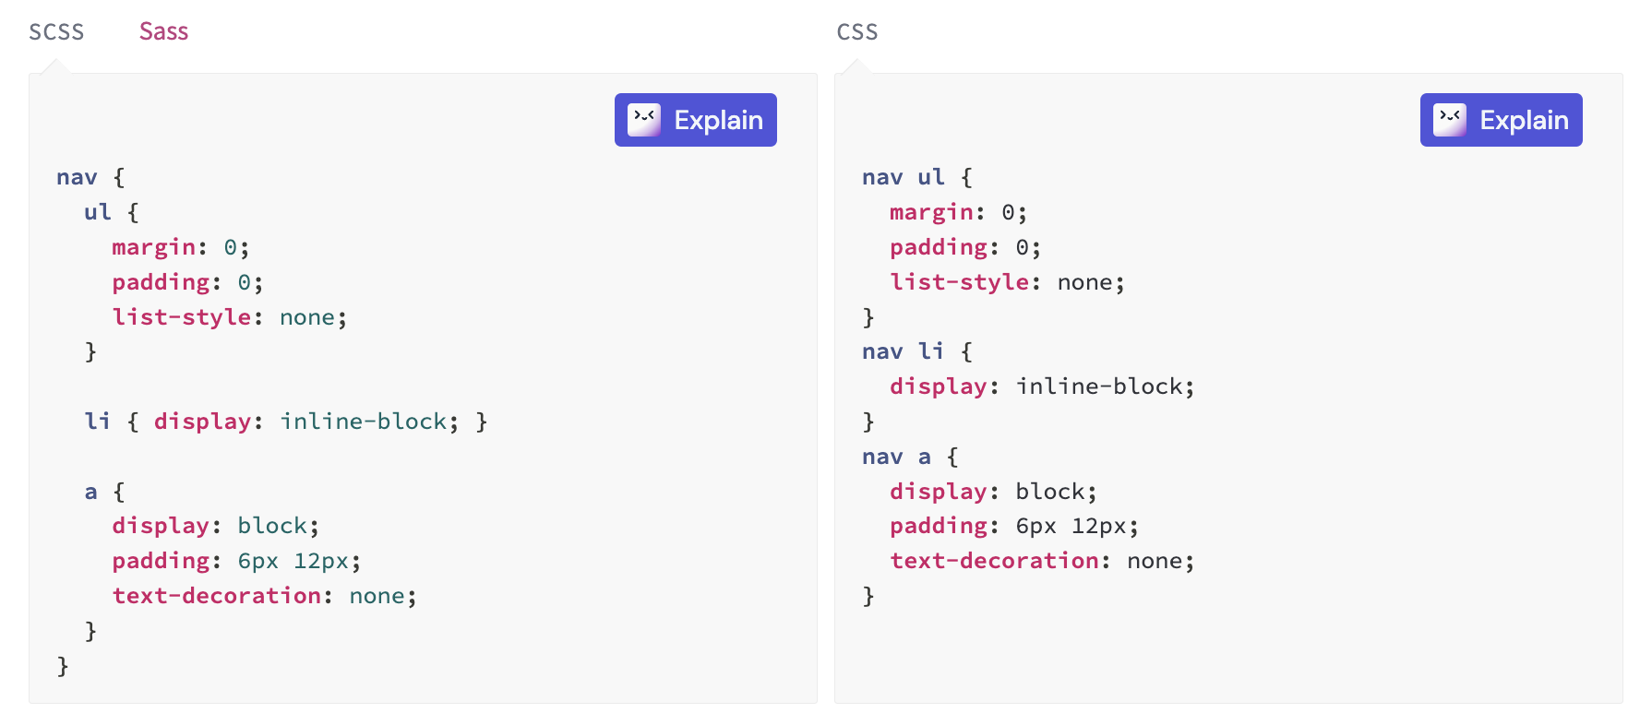
Nesting
Sass wants to make your CSS code easier, Rather than selecting the same selector again and again.
you can write one style rule inside another. Sass will automatically combine the outer rule’s selector with the inner rule’s

Slide 10
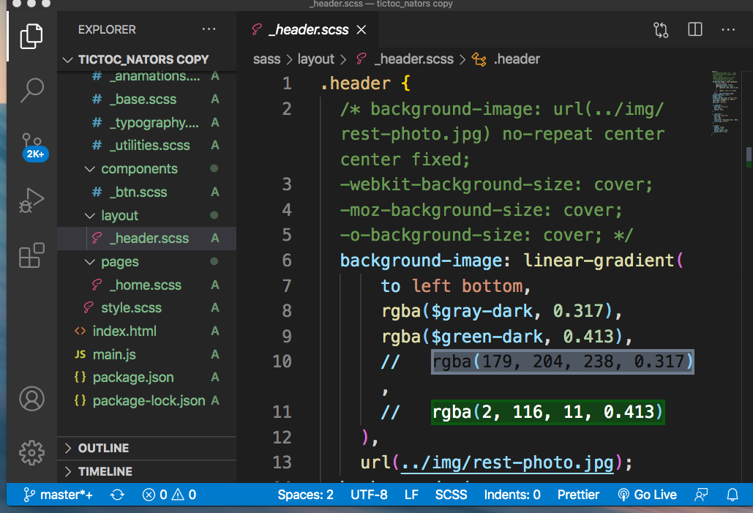
Partials
SCSS code that will loaded as a modules, not being complied on their own.
These begin with _ (as in _code.scss).
Partials can be used in IQX CSS style to reduce copying more style every time for Grid and filters.

Slide 11
Interpolations
Interpolation is basically an insertion of scss or css at dynamically.
To interpolate an expression we need to wrap the expression using #{}.

Slide 12
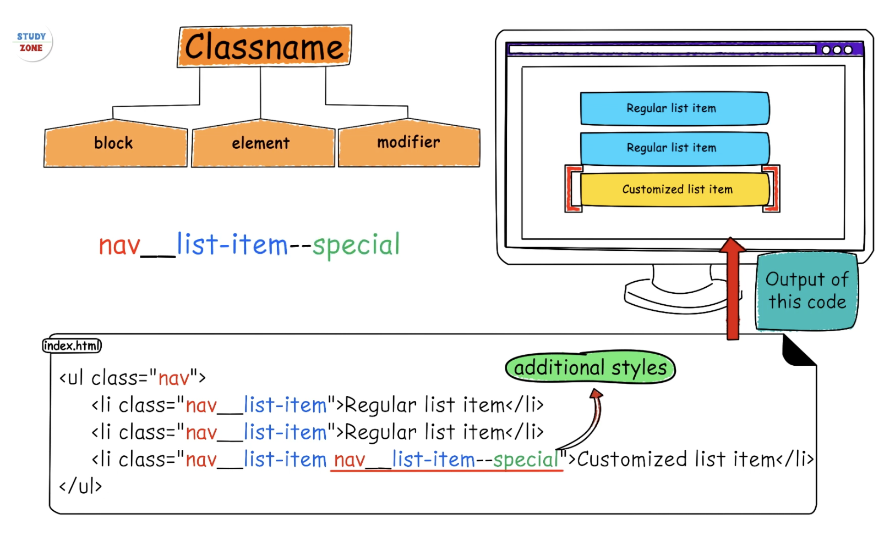
Inheritance
There are often cases when designing a page when one class should have all the styles of another classes, as well as its own specific styles.
The BEM (Block__Element__Modifier) is a coding methodology that simplifies the development of reusable and accessible stylesheets using the scss for CSS.

Slide 13
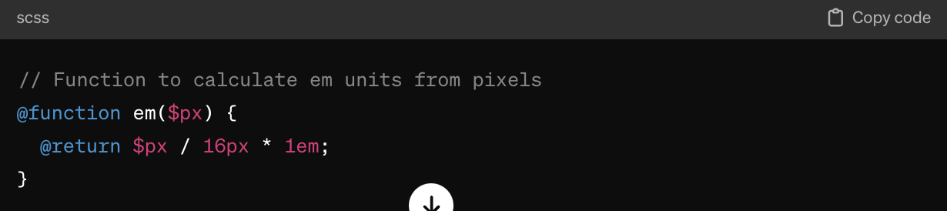
Functions
Sass allows the creation of custom functions to perform specific tasks within stylesheets.
They enable reuse of login and calculations throughout the stylesheet, promoting efficiency and consistency.

Slide 14
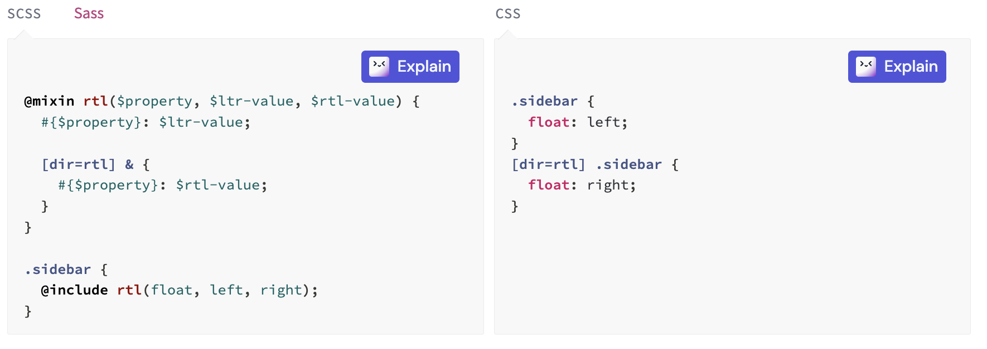
Mixins
The @mixin directive lets you create CSS code that is to be reused throughout the website.
The @include directive is created to let you use (include) the mixin.

Slide 15
Flow Controls
@if controls whether or not a block is evaluated.
@each evaluates a block for each element in a list or each pair in a map.
@for evaluates a block a certain number of times.
@while evaluates a block until a certain condition is met.

Slide 16

Thank you

